Slide 1
Chapter 7: Decision Trees

Slide 2
Introduction
One of the most powerful directed data mining techniques
Related to table lookup models
Recursively split data into smaller and smaller cells which are increasingly “pure” in the sense of having similar values of the target.
Uses the target variable to determine how each input should be partitioned.

Slide 3
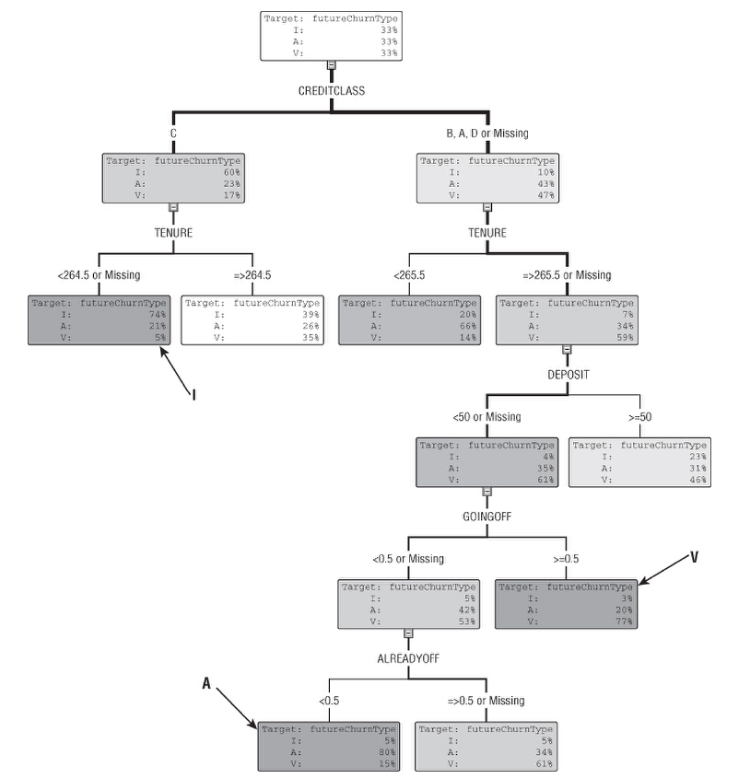
What Is a Decision Tree and How Is It Used?
Decision Tree:
a hierarchical collection of rules that describes how to divide a large collection of records into successively smaller groups of records.

Slide 4
A Typical Decision Tree
Root node : contains all the training data used to grow the tree.
Leaves: nodes that ultimately get used are at the ends of their branches, with no children.
Path from the root node to a leaf: describes a rule for the records in that leaf.

Slide 5
Using the Tree to Learn About Churn
The decision tree describes who is doing the churning and which of two variants of churn is more common in particular segments.
Voluntary churn VS Involuntary churn
The first split in the tree is on credit class.
The split drastically changes the distribution of the target in each of the children.
In the full tree, most leaves are dominated by a single class.

Slide 6
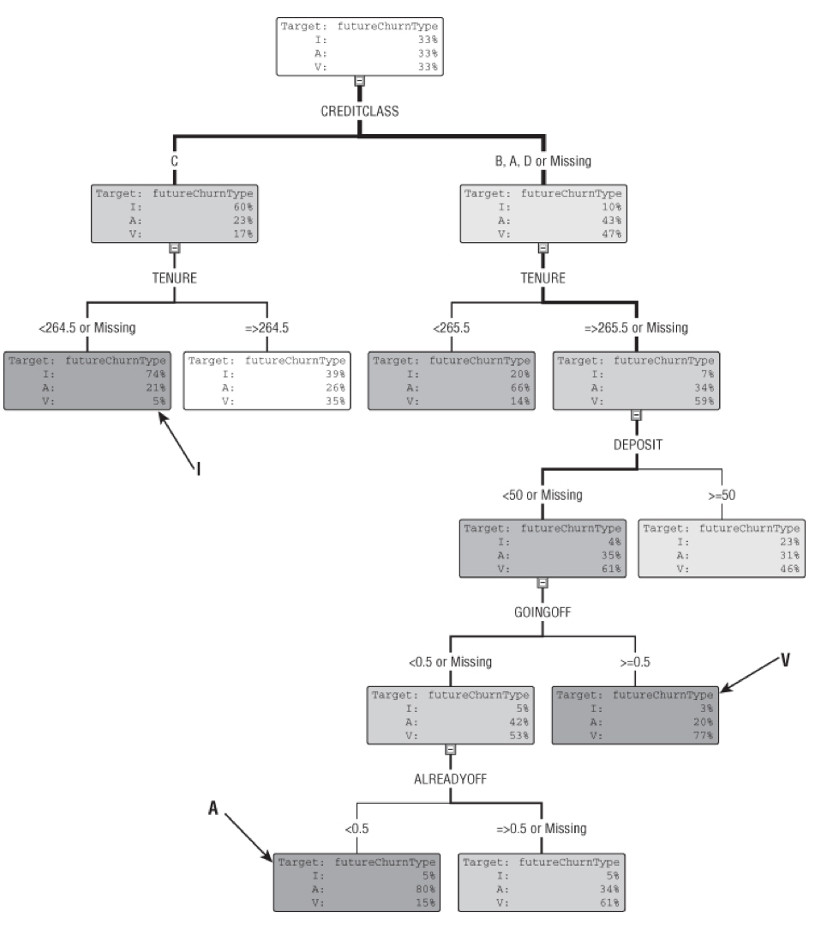
Using the Tree to Learn About Churn
leaf marked I: These subscribers are credit class “C” and have tenure of 264 days or less.
node marked V: These subscribers pay no deposit (the smallest deposit is $100) and have been around for at least 265 days.
leaf marked A:these subscribers are still on contract and not about to go off contract.

Slide 7
Using the Tree to Learn About Data and Select Variables
Use five variables from among the many available in the model set.
they do a good job of explaining voluntary and involuntary churn.
first split uses credit class:better separating job than other variables
In general, decision trees do a reasonable job of selecting a small number of fairly independent variables
Different choices of target variable create different decision trees containing different variables.

Slide 8
Picking Variables for a Household Penetration
Model at the Boston
Estimate a town's expected home delivery circulation level
Target variable: high or low penetration - the proportion of households that subscribe to the paper.
Figure out which factors separate towns with high penetration (the “good” towns) from those with low penetration (the “bad” towns).
The U.S. Census Bureau makes hundreds of variables available.
Before building the regression model, we used decision trees to explore the possibilities.

Slide 9
Picking Variables for a Household Penetration
Variables selected:
Median home value as the first split
A family of derived variables comparing the subscriber base in the town to the town population as a whole as the second split
Average years of school completed
Percentage of the population in blue collar occupations
Percentage of the population in high-status occupations.
Some variables picked by the decision tree were less suitable for the regression model.
The decision tree provides guidance about which variables to think about as well as which variables to use.

Slide 10
Using the Tree to Produce Rankings
Decision trees score new records by looking at the input variables in each new record and following the appropriate path to the leaf.
The ordering of the scores is more important than the actual scores themselves.
Example: Deciding certain number customers for campaign.
The purpose of the model is to find the 10,000 customers most likely to churn
determining the actual churn rate is not important.

Slide 11
How Is Decision Tree Used (cont.)
Using the Tree to Estimate Class Probabilities
The class probabilities are obtained from the leaves.
Using the Tree to Classify Records
Estimate the class probabilities as described earlier and label each leaf with its most probable class.
Using the Tree to Estimate Numeric Values
Regression tree is built so that records in any given leaf all have target values close to the average for that leaf — or in the language of statistics, the goal is to minimize the variance of the target values in each leaf.

Slide 12
Decision Trees Are Local Models
Decision trees, carve the input space into segments and produce a separate estimate for each local phenomena

Slide 13
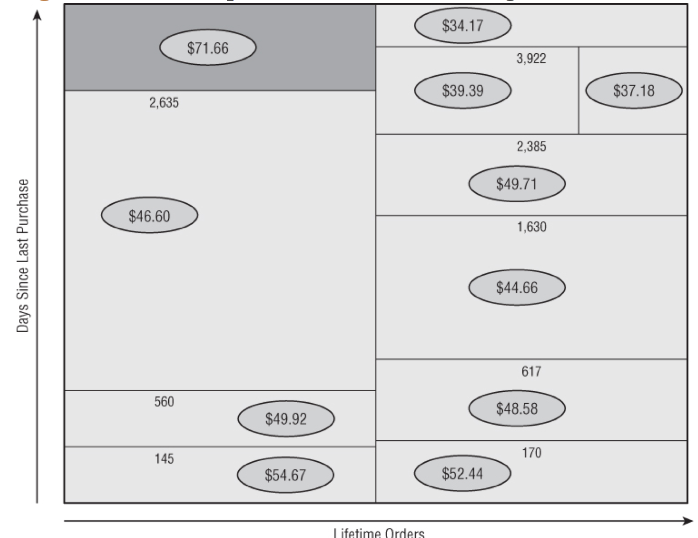
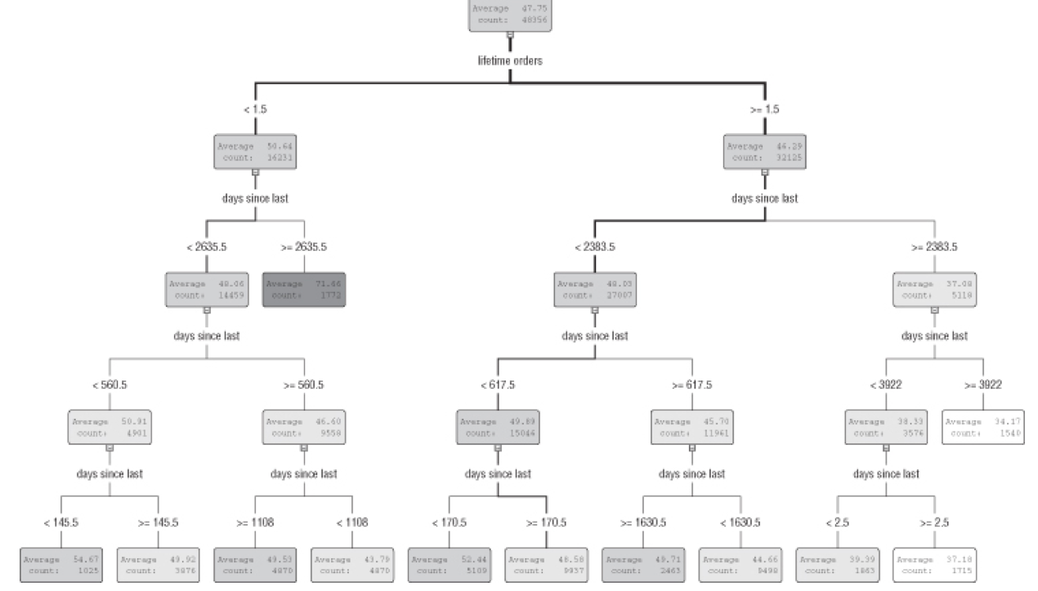
Decision Trees Are Local Models

Slide 14
Growing Decision Trees
The decision tree algorithm repeatedly splits the data into smaller and smaller groups： each new set of nodes has greater purity than its ancestors with respect to the target variable.
A binary, categorical target variable, such as responder/nonresponder would simplifies the explanations without much loss of generality.

Slide 15
Finding the Initial Split
The goal is to build a tree that uses the values of the input fields to create rules that assign a target value to each record.
The measure used to evaluate a potential split is purity of the target variable in the children.
Low purity: the distribution of the target in the children is similar to that of the parent node
High purity:members of a single class predominate.
The best split is the one that increases purity in the children by the greatest amount.

Slide 16
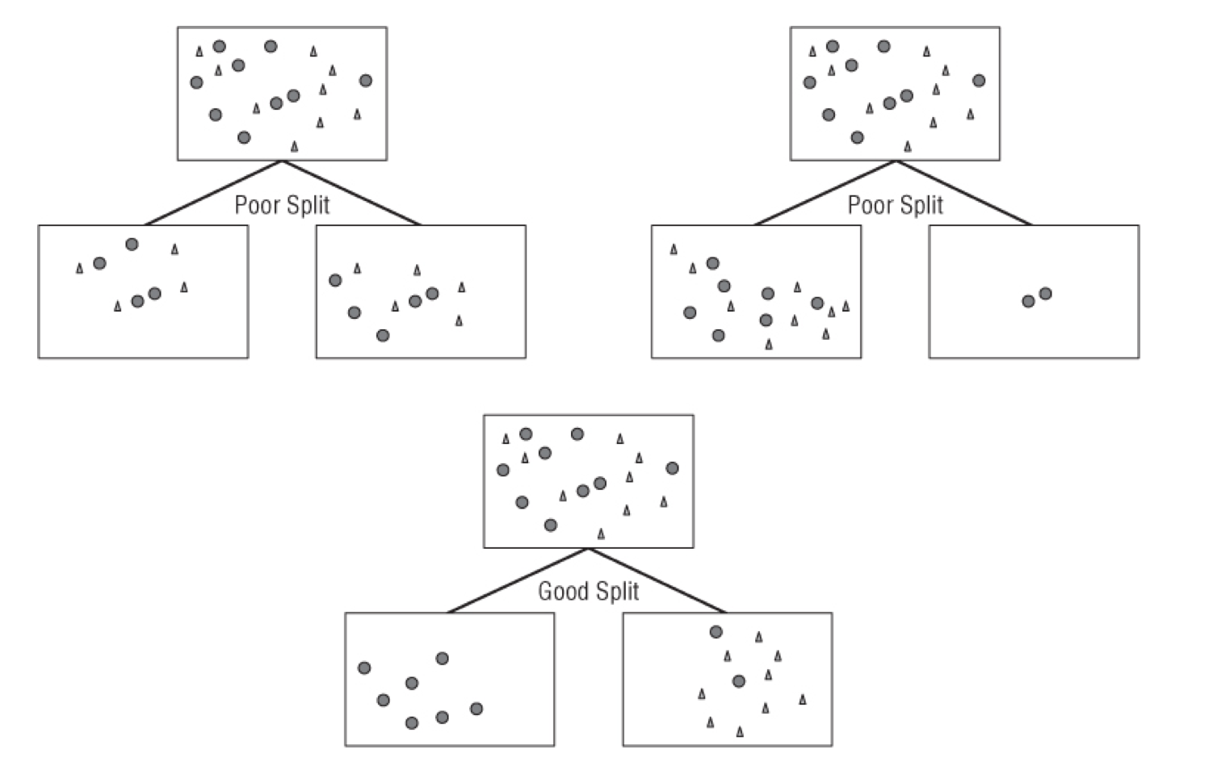
Finding the Initial Split
A good split increases purity for all the children

Slide 17
Splitting on a Numeric Input Variable
Splits on a numeric variable take the form X<N.
X<N—> one child vs X>N—> another child
After each split, the increase in purity due to the split is measured.
When the decision tree is scored, numeric inputs is used to compare their values with the split points.

Slide 18
Splitting on a Categorical Input Variable
The simplest algorithm for splitting on a categorical input variable is to create a new branch for each class that the categorical variable can take on.
A better and more common approach is to group together classes that, taken individually, predict similar outcomes.
For a binary target, the simplest approach is to determine the proportion of the target for each value of the input variable.
A more sophisticated approach looks at the distributions of the target within each value of the input variable, and combines values whose distributions are very similar

Slide 19
Splitting in the Presence of Missing Values
Decision trees allow to use null as an allowable value to handle missing values in input fields.
A particular value is null has predictive value.
An alternative approach to missing values is keeping several splitting rules (surrogate splits) for each node.
When a null value is encountered in the field that yields the best split, the next best rule can be used.

Slide 20
Growing the Full Tree
Recursive algorithm: The initial split produces two or more children, each of which is then split in the same manner as the root node.
Tree building stops, for one of three reasons:
No split can be found that significantly increases the purity of any node‘s children.
The number of records per node reaches some preset lower bound.
The depth of the tree reaches some preset limit.

Slide 21
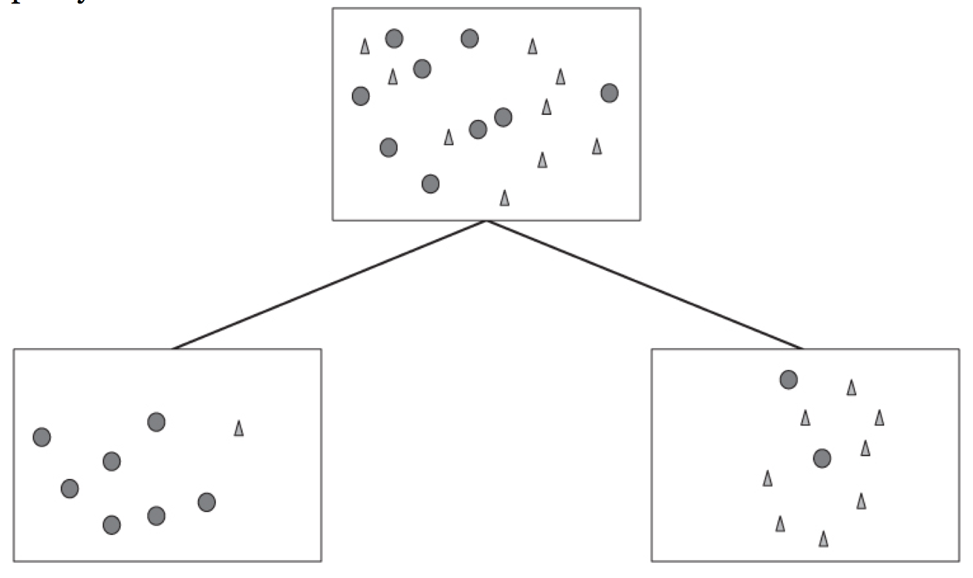
Finding the Best Split
Alternate splitting criteria often lead to trees that look quite different from one another, but have similar performance.
A good split on a binary categorical variable increases purity.

Slide 22
Finding the Best Split
Purity measures for evaluating splits for categorical target variables include:
Gini (also called population diversity)
Entropy (also called information gain)
Chi-square test
Incremental response
Purity measures for evaluating splits for numeric, target variables include:
Reduction in variance
F test

Slide 23
Gini (Population Diversity) as a Splitting Criterion
A score of 0.5 means that two classes are represented equally.
Calculation of Gini: the sum of the squares of the proportions of the classes in the node.
To calculate the impact of a split, take the average of the Gini scores of the children, weighted by the size of each child.
A perfectly pure node has a Gini score of 1. A node that is evenly balanced has a Gini score of 0.5.

Slide 24
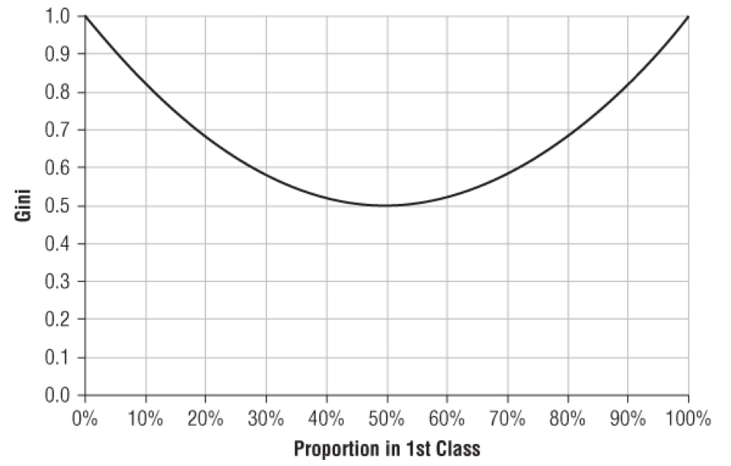
Gini (Population Diversity)
For a binary target, the Gini score varies from 0.5 when there is an equal number of each class to 1 when all records are in the same class.

Slide 25
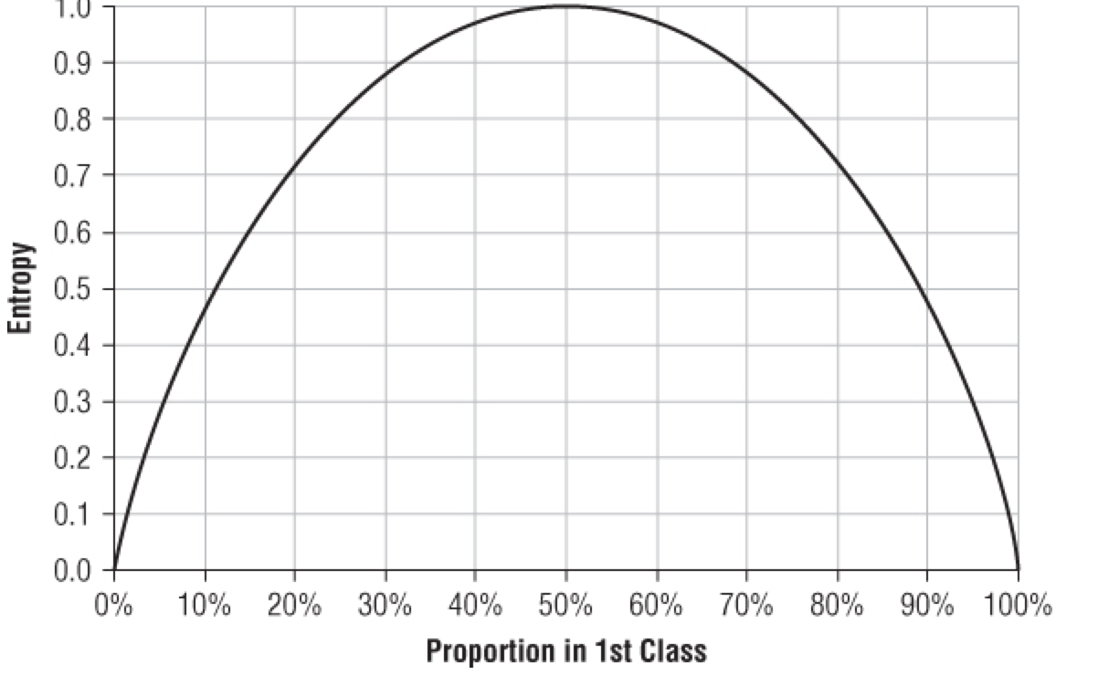
Entropy Reduction or Information Gain as a Splitting Criterion
An entropy score of 1 means that two classes are represented equally. When a node has only one class, its score is 0. So, purer nodes have lower scores, and the goal is to minimize the entropy score of the split.

Slide 26
Entropy Reduction
For a binary target variable, the formula for the entropy of a single node is:
To calculate the total entropy of the system after the split, multiply the entropy of each node by the proportion of records that reach that node and add them up.

Slide 27
Information Gain Ratio
information gain uses the ratio of the total information gain due to a proposed split to the intrinsic information attributable solely to the number of branches created as the criterion for evaluating proposed splits.
This test reduces the tendency towards very bushy trees

Slide 28
Chi-Square Test as a Splitting Criterion
For a child node, the chi-square value is the sum of the squares of the differences between the expected and observed frequencies of each value of the target, divided by the expected frequency.
The chi-square value of a split is simply the sum of the chi-square values of all the children
Higher values of chi-square mean that the variation is more significant

Slide 29
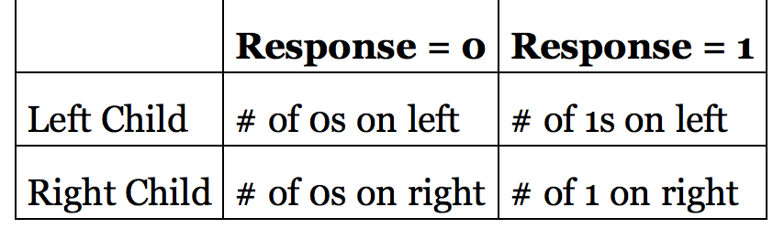
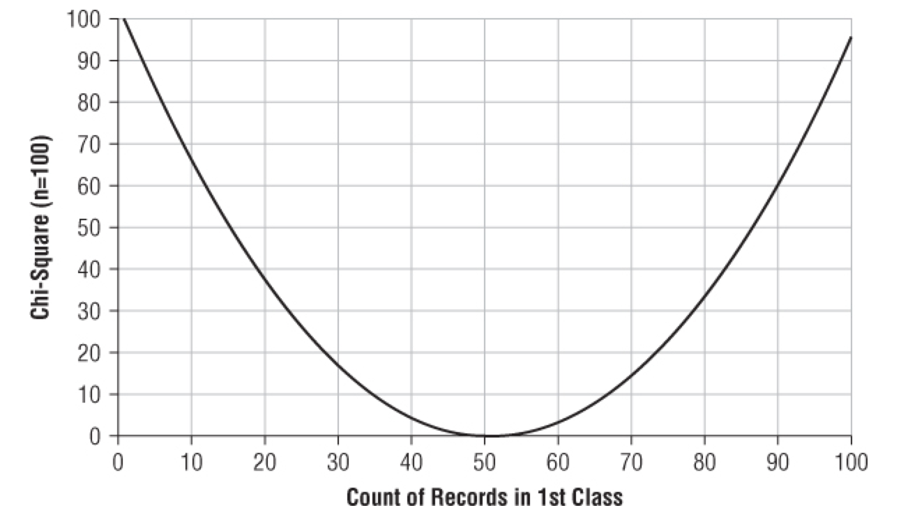
Chi-Square Test
Contingency Table for Split Evaluation
Chi-square is 0 when the sample distribution is the same as the population‘s.
This is measured by looking at the proportions of the target in the children.
Chi-square value does not have a restricted range such as 0 to 1; it grows larger as the amount of data grows.

Slide 30
Incremental Response as a Splitting Criterion
Build two different response models — one for probability of response given treatment (the test group) and one for probability of response given no treatment (the control group).
The best split is the one that maximizes the difference in response between the two groups.

Slide 31
Reduction in Variance as a Splitting Criterion for Numeric Targets
Variance is a measure of the extent to which values in a sample stay close to the average value.
Another way to measure a good split is that such a split should reduce the variance of the target variable.

Slide 32
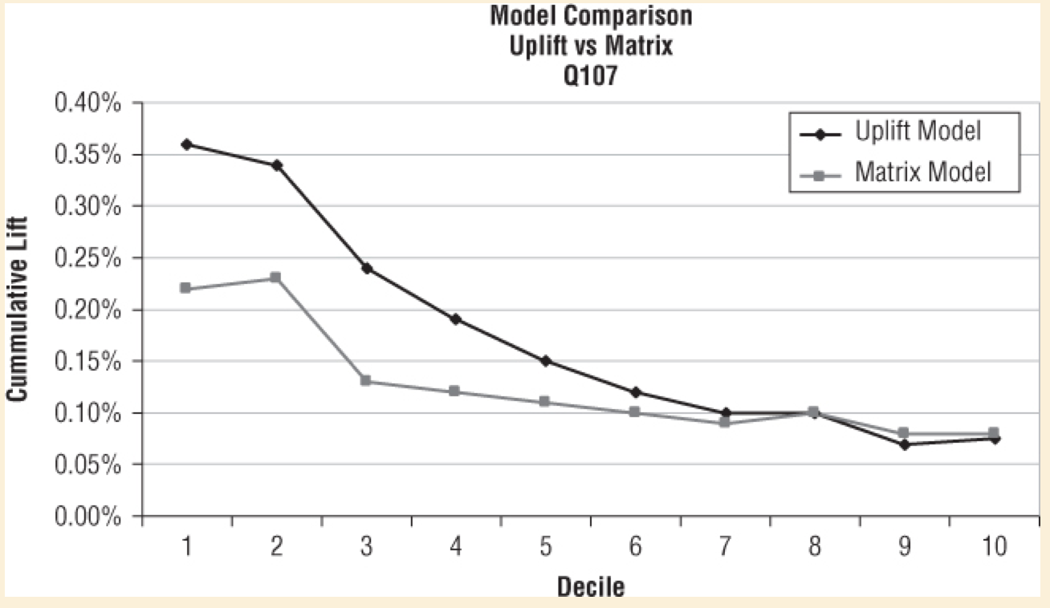
U.S. Bank Improves Incremental Response
Several approaches to modeling incremental response.
The Difference Model
The Matrix Model
The Portrait Uplift Optimizer

Slide 33
F Test
Used for numeric target variables
Provides a measure of the probability that samples with different means and variances are actually drawn from the same population.
The F test looks at the relationship between two estimates of the population variance
It is calculated by dividing the between-sample estimate by the pooled sample estimate.
a large F score indicates that a proposed split has successfully split the population into subpopulations with significantly different distributions.

Slide 34
Pruning
One way to avoid overfitting is to set a large minimum leaf size.
Another approach allows tree to grow as long as there are splits that appear to be significant on the training data and then eliminate the splits that prove to be unstable by cutting away leaves through a process called pruning.

Slide 35
The CART Pruning Algorithm
Step 1:
The CART algorithm identifies a set of such subtrees as candidate models.
Step 2:
The candidate subtrees are applied to the validation set, and the tree with the lowest validation set misclassification rate (or average squared error for a numeric target) is selected as the final model

Slide 36
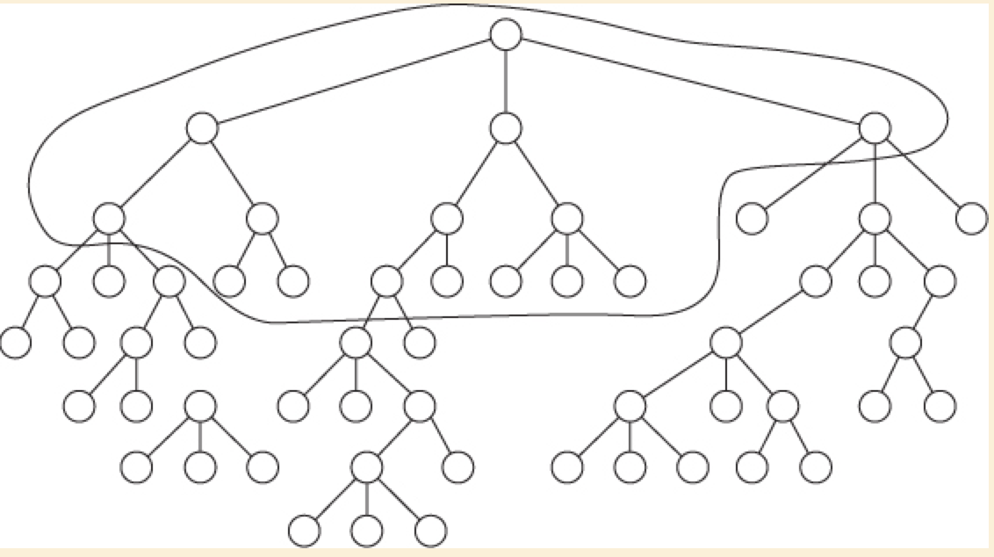
The CART Pruning Algorithm

Slide 37

The CART Pruning Algorithm
Creating Candidate Subtrees
To identify these least useful branches, CART relies on a concept called the adjusted error rate.
The formula for the adjusted error rate is:

Slide 38
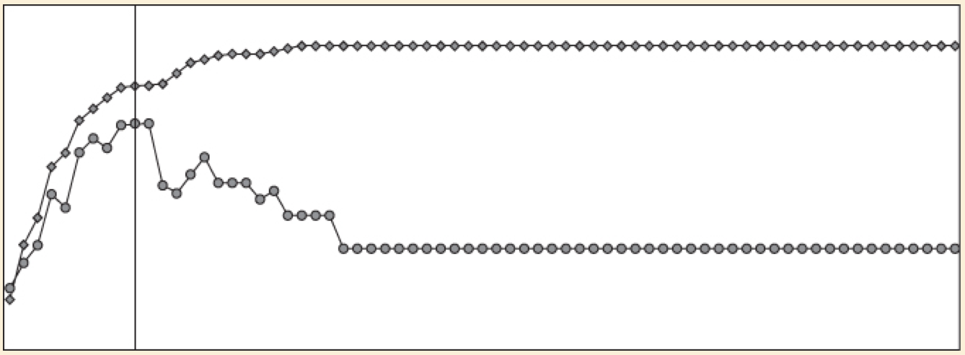
The CART Pruning Algorithm
Comparing Misclassification Rates on Training and Validation Sets
The error rate on the validation set should be larger than the error rate on the training set
A large difference in the misclassification error rate is a symptom of an unstable model.
The percent correctly classified in the validation set.

Slide 39
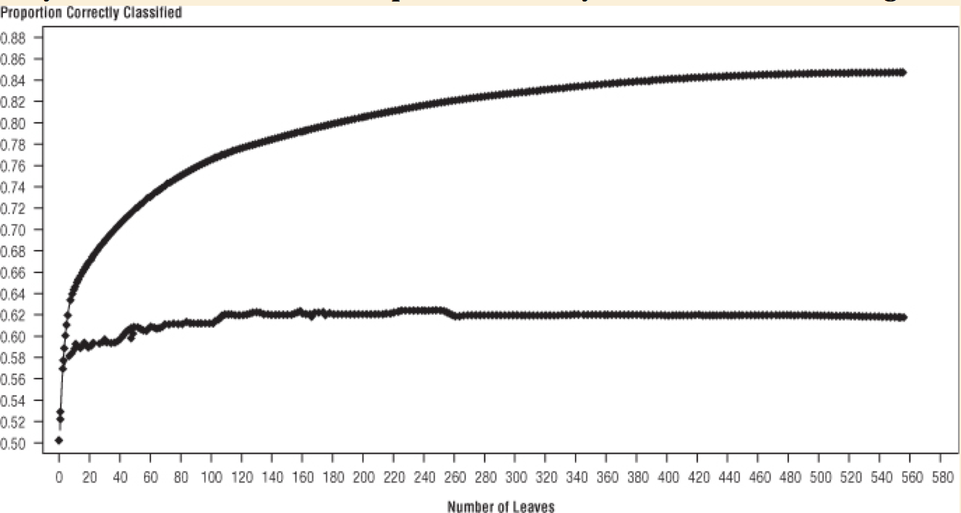
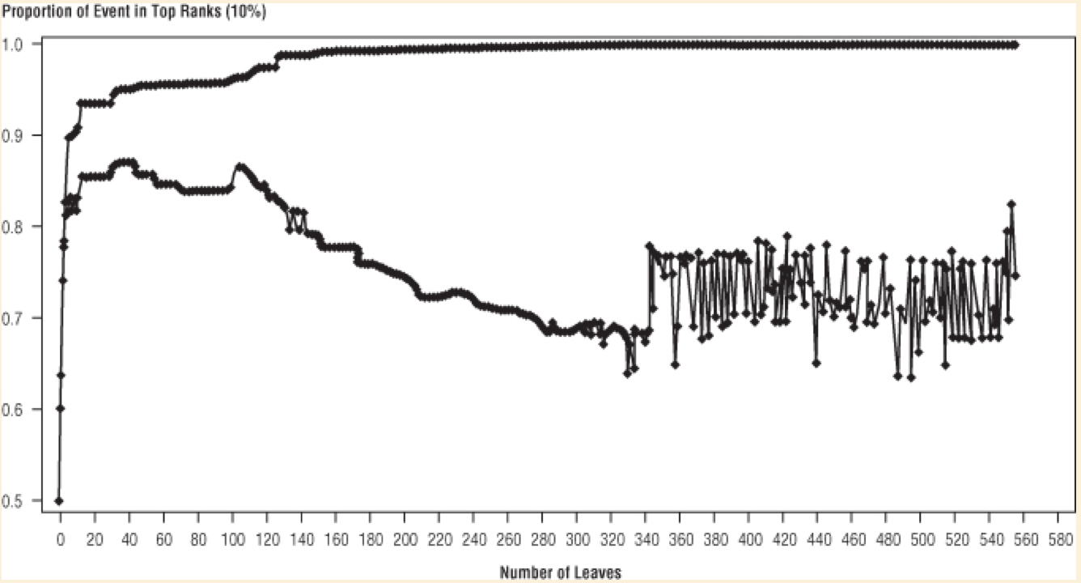
The CART Pruning Algorithm
The percent correctly classified in the validation set levels off early and remains far below the percent correctly classified in the training set.
the percent correctly classified on the validation set decreases with the complexity of the tree and eventually becomes chaotic

Slide 40
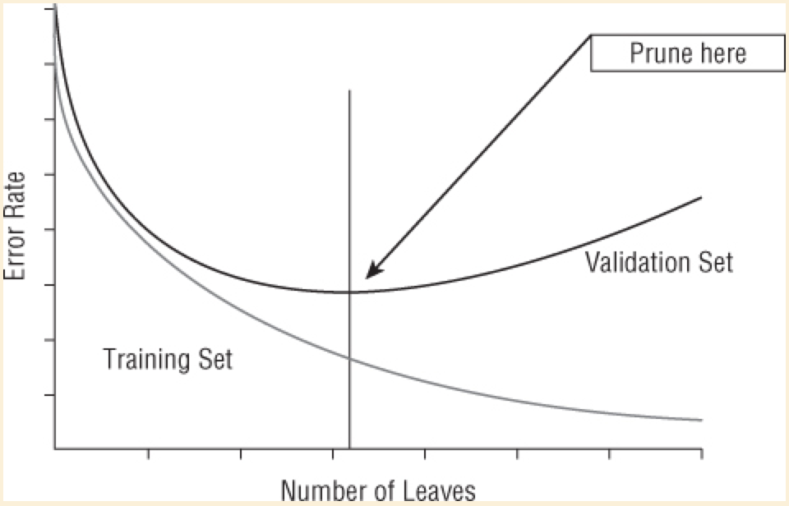
The CART Pruning Algorithm
Picking the Best Subtree
Select from the pool of candidate subtrees, the one that works best on new data.
Pruning chooses the tree whose miscalculation rate is minimized on the validation set.

Slide 41
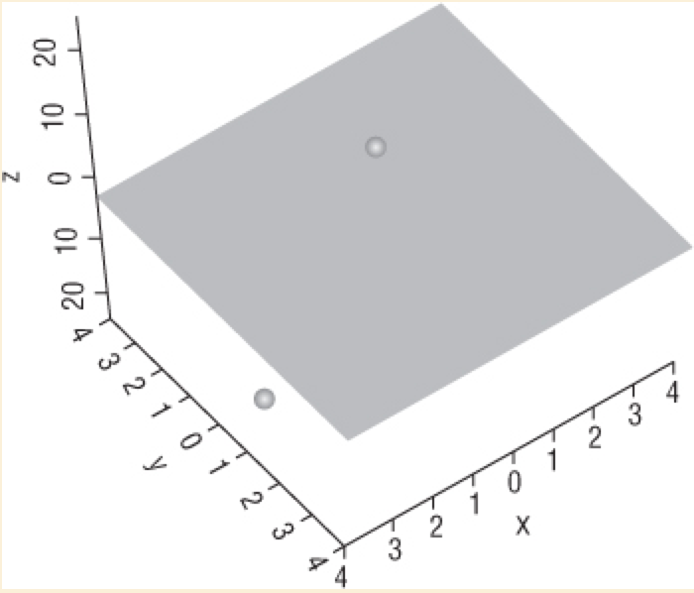
Support Vector Machines
Support vector machines are a geometric method of separating two classes by finding the best hyperplane that puts one class above it and the other below.
A two-dimensional plane separating points in three dimensional space:

Slide 42
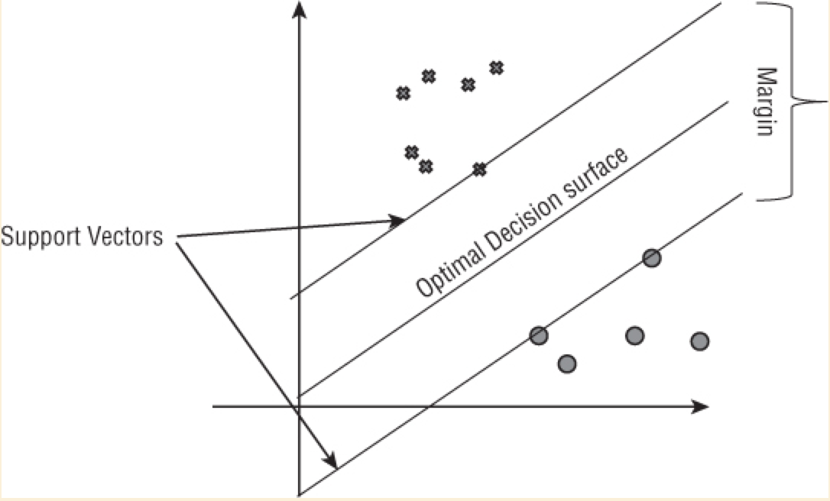
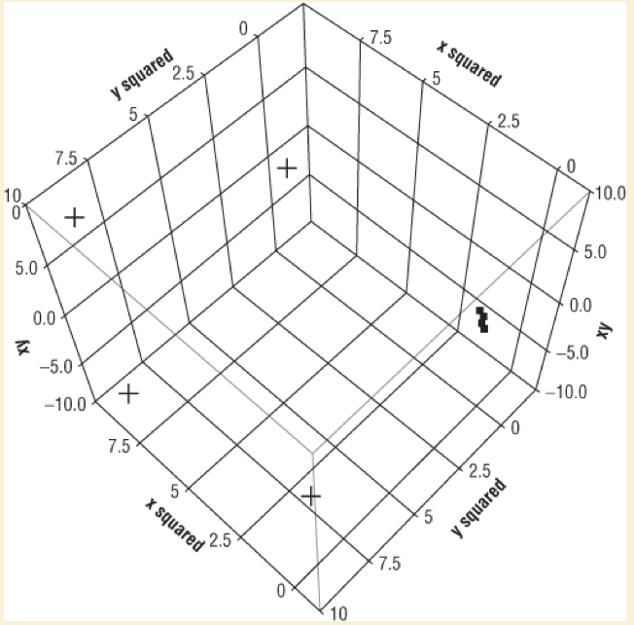
Support Vector Machines
A one-dimensional line separating points on a two-dimensional plane.
Boundary between the two classes is not a straight line.

Slide 43
Assessing the Quality of a Decision Tree
The effectiveness of a decision tree, is determined by applying it to the test set and observing the percentage classified correctly by a classification tree
Quality of the individual branches of the tree:
The number of records entering the node
The proportion of records in each class or the average value of the target variable
How those records would be scored if this were a leaf node
The percentage of records classified correctly or the average squared error
The difference in distribution between the training set and the test set

Slide 44
When Are Decision Trees Appropriate?
There is often a trade-off between model accuracy and model transparency.
Decision trees have been used in some very imaginative ways

